Slide 1



Can We Predict Germination Success in Seed Pellets using Seed Traits?
By Paige Thompson

Slide 2
Restoration and Why it’s Important
Ecological restoration: “the process of assisting the recovery of an ecosystem that has been degraded, damaged, or destroyed”
Restoration projects often seed native species and despite financial and logistical investments, many of these seeding projects fail in arid lands (Gornish, Arnold, and Fehmi 2019)
Plant traits are defined as morphological, physiological or phenological features of individual plants
(Violle et al. 2007)
→ Provide insight into how plants are adapted to current and future climate conditions
Understanding how plant traits can improve restoration practices is important to preserving
and restoring the southwest

Slide 3
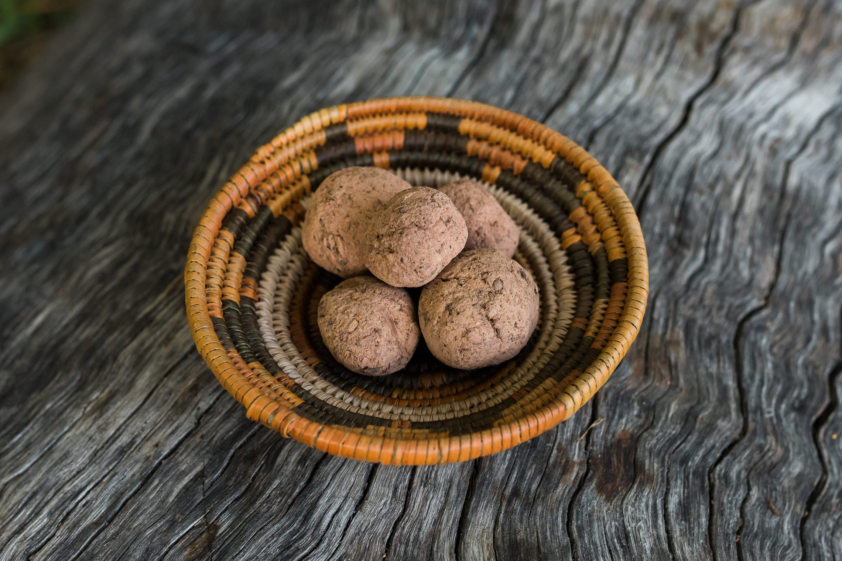
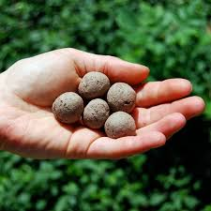
What Are Seed Pellets
Native Seed
Seeds are coated by a protective layer
→ clay, soil, and/or compost
Provide protection from predation
Gives additional nutrients that can aid in germination and seedling establishment
Has roots in ancient times (Schreiber, 2014) & is becoming more popular in modern
times

Slide 4
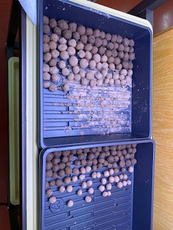
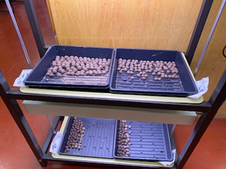
Seed Pellets
Arid environments face many challenges
→ Irregular precipitation, seed predators, harsh surface conditions, native seeds poorly suited to mechanical distribution
Seed pellets can combat these issues
There is not a lot of quantitative data on pellets
These pellets contain: floated red clay, coconut husk, compost, and vermiculite
Seed pellet goals: enhanced germination and establishment, protect from predators, &
improved distribution

Slide 5
Hypotheses & Goal
Hypothesis one: Smaller seeds will have higher germination rates in smaller pellets, while larger seeds will have higher germination in larger pellets
Hypothesis two: Based on seed characteristics, the Mexican Poppy species will do better than the Blue
Flax
The goal is to figure out how to match seed characteristics with pellet characteristics to achieve
higher restoration success rates

Slide 6
Experimental Design

Slide 7
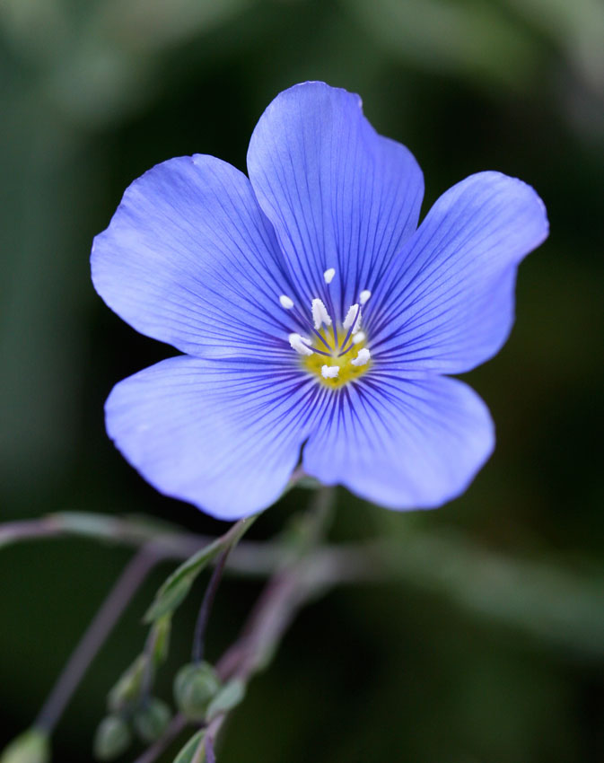
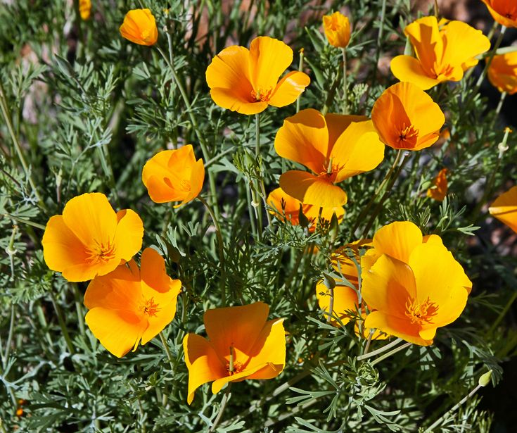
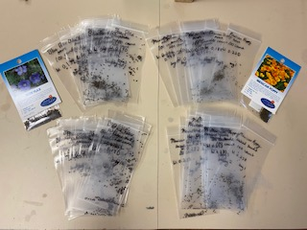
Species
Species selected: Argemone mexicana & Linum lewisii
Common names: Mexican Poppy & Blue Flax
Good for restoration: drought tolerant, common
Importance: pollinators

Slide 8
Methods
STEPS
Weighed all seeds
20 bags total, 10 bags of 100 seeds for each species for the bare seeds
20 bags total, 10 bags of 100 seeds per species for the seed pellets
Bare seeds were placed on damp paper towels on growing racks & monitored
Seed pellets were constructed in 2 sizes (1/4 inch and 1 inch) with 5 seeds per pellet
Both bare and coated seeds were kept continuously moist
Data was collected

Slide 9
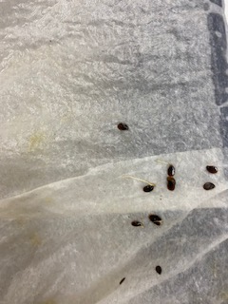
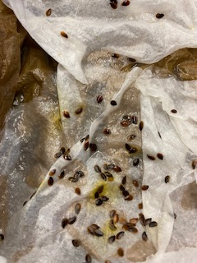
Bare Seeds
Studies found 5% germination success rate in restoration without coatings/protective layer
Seeding with bare seeds is a common restoration practice for arid environments
In arid environments seeds tend to have less nutrients stored & need water as soon as possible

Slide 10
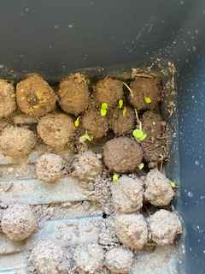
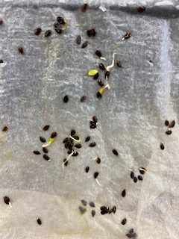
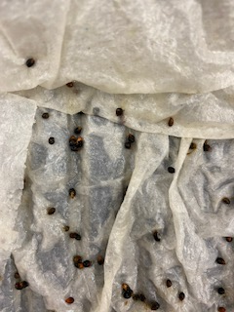
Results
Over the course of 5 weeks:
14.1% of bare seeds for Mexican Poppy germinated
51.7% of bare seeds for Blue Flax germinated
→ Slower to start germinating
Over 5 weeks:
4.5% germination for Blue Flax pellets
0% germination for Mexican Poppy pellets
Mexican Poppy seeds: 0.246 g - weight mass heavier, rounder and rough texture
Blue Flax seeds: 0.140 g - weight mass lower, oval-like and smooth texture

Slide 11
Conclusion
The Mexican Poppy seeds had a low germination success rate
Blue Flax seeds had a little over 50% germination success rate
Germination in pellets were lower than expected
→ Blue Flax showed germination
Hypothesized the Mexican Poppy would do better based on initial response
Blue Flax pellets showed the most growth
For restoration smaller pellets should be considered
→ Environment conditions play an important role
Water breaks down the smaller pellets a lot faster than the larger ones
→ Do want breakdown, however too quick breakdown is bad

Slide 12
References
Gornish, Elise, Hannah Arnold, and Jeffrey Fehmi. "Review of seed pelletizing strategies for arid land restoration." Restoration Ecology 27.6 (2019): 1206-1211.
Schreiber, Andrew. “Making Seedballs: An Ancient Method of No-till Agriculture.” The Permaculture Research Institute, 11 Dec. 2016.
Violle, Cyrille, et al. "Let the concept of trait be functional!." Oikos 116.5 (2007): 882-892.

Slide 13
Acknowledgments
&
Questions

